Slide 1
Puritans and Puritanism

Slide 2
Puritanism only
This powerpoint covers Puritanism only. The next one will begin with the background to the revolution having to do with the Seven Years War…

Slide 3
A Short History of the Reformation and the Church of England
1517: Martin Luther posted his “Ninety-Five theses” disputing the sale of Papal indulgences and absolution of sins.
1534: English Parliament passes the first Act of Supremacy making Henry VIII the Supreme Head of the Church of England, effectively breaking free from the Catholic Church and papal authority.

Slide 4
Dissolution of the Monasteries
1535-1540: Thomas Cromwell instituted the policy known as the “Dissolution of the Monasteries.”
• The veneration of some saints, certain pilgrimages and some pilgrim shrines were attacked.
• Large amounts of church land and property passed into the hands of the Crown and ultimately into those of the nobility and gentry.
• The vested interest thus created made for a powerful force in support of the dissolutions.

Slide 5
Continued
1536: John Calvin published his Institutes of the Christian Religion.
1553-1558: a Brief Restoration occurred with the ascension of Queen Mary.
1559: With Elizabeth’s ascension to the throne, the Anglican Church, for all intents and purposes, was permanently established.

Slide 6
Queen Elizabeth’s Reforms
Latin was rejected
Auricular confession was abolished
Clergy were allowed to marry

Slide 7
Reforms Not Enough for “Puritans”
Those who we call the “Puritans,” at first a term of derision, wanted more profound changes in the structure of churches and manner of worship.
These changes begin, as did Elizabeth’s reforms, with the “purging of popish remnants.”
They wanted to eliminate the wearing of the cassock outside of church and the surplice in it.
This elimination of Catholic elements involved eliminating the clerical hierarchy of Catholicism in order to get closer to God and His word.
In place of this longstanding clerical hierarchy would be the creation of a simultaneous Christian community and congregation united in a shared orientation toward God.

Slide 8
Predestination
The purifying changes reflected a more profound change in everyday lives signified by the concept of “predestination”—the idea that “the elect,” (those going to heaven) are preordained, and ones life and behavior reveals that electedness in their appearance as a “visible saint.”

Slide 9
Puritan Community
While most Puritans preferred a governing body of church elders (Presbyterian model) to the more conventional church hierarchy, William Bradford and the eventual Plymouth colonists (separatists) did not want clergy assigned to a parish by any ecclesiastical authority.
They believed that churches, or congregations, should be ‘particular;’ that is, each one covenanted by a group of Christians who wished to come together for prayer and participation in the Lord’s Supper.
This community had a right to choose their spiritual leaders, to call someone to them. It is the special sense of community that informs Bradford’s Christian ideal.

Slide 10
The Mayflower
On July 1, 1620 the Pilgrim separatists signed a contract with Thomas Weston, and three weeks later sailed for England.
After having trouble with a second ship called the Speedwell that was also supposed to make the journey, all the colonists (about 101) and crew (around 30) all crowded onto the Mayflower.
They were originally supposed to land near the Hudson River in what would one day be New York, but they were blown off course and landed at Cape Cod 65 days after their departure. It was November.
Six weeks after they anchored, Bradford’s wife Dorothy fell overboard—most historians think this was a suicide attempt.
In 1621 the colony’s original governor John Carver died, and Bradford became governor, serving a total of 33 years and continually from 1627-1656.

Slide 11
The Mayflower Compact
In the name of God, Amen.
We, whose names are underwritten, the loyal subjects of our dread Sovereign Lord King James, by the Grace of God, of Great Britain, France, and Ireland, King, defender of the Faith, etc.
Having undertaken, for the Glory of God, and advancements of the Christian faith and honor of our King and Country, a voyage to plant the first colony in the Northern parts of Virginia, do by these presents, solemnly and mutually, in the presence of God, and one another, covenant and combine ourselves together into a civil body politic; for our better ordering, and preservation and furtherance of the ends aforesaid; and by virtue hereof to enact, constitute, and frame, such just and equal laws, ordinances, acts, constitutions, and offices, from time to time, as shall be thought most meet and convenient for the general good of the colony; unto which we promise all due submission and obedience.
In witness whereof we have hereunto subscribed our names at Cape Cod the 11th of November, in the year of the reign of our Sovereign Lord King James, of England, France, and Ireland, the eighteenth, and of Scotland the fifty-fourth, 1620.

Slide 12
Questions
1. How does this document prefigure what is to come, in the form of an American desire for self-government?

Slide 13
Order
Puritans valued order above all other social virtues.
Jonathan Edwards: “There is a beauty of order in society, as when the different members of society have all their appointed offices, place, and station, according to their several capacities and talents, and everyone keeps his place, and continues in his proper business.”
Whether it was the perceived disorderliness of Indian villages, the criminality of English towns bursting with vagrants, or the wildernesses of New England, Puritans sought to bring order to their lives.

Slide 14
Relation to Entrepreneurial Values
Puritan values helped the colonists prosper in a demanding land, and in the process they developed a culture that was both the most entrepreneurial and the most pious in Anglo-America.
This entrepreneurialism, rooted in piety, led New England to have a particularly commercial character.
The Puritans worked with a special zeal to honor their God and to seek rewards that offered reassurance that God approved of their efforts.

Slide 15
Preserving Englishness
Two ways in which they sought to preserve their distinctive Englishness:
1. Change the land
2. Convert the Indians to Christianity (making them English)

Slide 16
Ordering Indian land
An Indian field consisted of small hillocks with maize in the center and squashes, pumpkins and beans tumbling down the sides.
This type of field struck the English as disordered and not “proper” in that each crop was not segregated and distinct.

Slide 17
Method
In fact there was a method to the chaotic appearance of the landscape:
• The squashes and pumpkins discouraged the appearance of weeds between the maize plants and preserved moisture by shielding the soil from the sun.
    • Interwoven roots strengthened plants against wind
• Cornstalks provided convenient poles for the bean vines
• Beans drew nitrogen from the air, which fixed the soil.
•The combination of plants provided a balanced diet

Slide 18
Changing the Land
The colonists diligently reworked the landscape to resemble England, which they regarded as God’s blueprint for a proper nature ‘improved’ by human labor.
They cleared and fenced fields for cultivation in the English fashion; built English style fences, houses, barns, mills, and churches; exterminated wild animals, especially the wolves and bears that preyed on livestock.

Slide 19
Property
Natives had a very different view of property in terms of both land and personal possessions.
Natives were mobile and decentralized into local bands of a few hundred or so people who shared a settled village for part of the year and a common hunting ground for the rest.
Bands and their chiefs competed against each other by waging wars meant to humiliate the defeated into paying tribute in deer skin and wampum (strings and belts of white and purple beads made from seashells and highly coveted as symbols of spiritual power and political authority)

Slide 20
Continued
Being mobile, natives did not accumulate personal property in the same was as the English.
The New English often tried to buy the land form the natives through an exchange of goods for property codified in legal “deeds” that the natives did not often understand as permanent in the English legal sense.

Slide 21
Pequot war
In 1636 the first major conflict erupted between the natives and the New English as the settlers tried to extend their authority into the mystic river valley.
The colonial leaders demanded a heavy tribute from the Pequot including wampum, several of their children, and also suspects accused of killing a trader.
When the Pequot failed to meet these demands the English declared war on them and enlisted their enemies the Mohegan and the Narrangansett.
In May of 1637 the New English and their Native allies surrounded and burned a sleeping village beside the Mystic River.

Slide 22
Praying Towns
At first the colonists did not want to missionize the Indians.
Rebuked in England for their slaughtering of the Pequot, some New English turned their attention to evangelizing the natives.

Slide 23
John Eliot
They first encouraged them to settle in one place…the architect of this missionary work, John Eliot:
  “Indians were doomed if they remained in “so unfixed, confused, and ungoverned a life, uncivilized and unsubdued to labor and order.”

Slide 24
Praying Indians
They separated those who were so inclined to Christianity from their intransigent loved ones and herded them into “praying towns,” usually taking the land that was abandoned.
Forced to:
-Take an English name
-Give up wearing body grease (paint)
-Give up playing traditional sports
-Cut their hair (men) very short in the English style
-Wear English clothes
-Men were forced to farm (could no longer hunt and fish)
-Women no longer tended the fields, but kept house and wove cloth

Slide 25
King Philip’s War
King Philip (Metacom) born to Wampanoag sachem Massoit became himself the Wampanoag chief in 1662.
In 1675 the Plymouth colonists provoked the war when they seized, tried, and hanged three Wampanoag for murdering a “praying Indian” who served as a colonial informant.
Wampanoag warriors retaliated by attacking isolated colonial homesteads on the frontier.
Drawing on the lessons of the Pequot war, the Indians waged “total war,” which entailed destroying whole settlements including women and children.
The war became particularly grisly and cruel with both sides engaging in torture and mutilation.

Slide 26
Winthrop
How do the themes of equality and cooperation appear in this sermon?
What does it mean to be a city upon a hill?

Slide 27
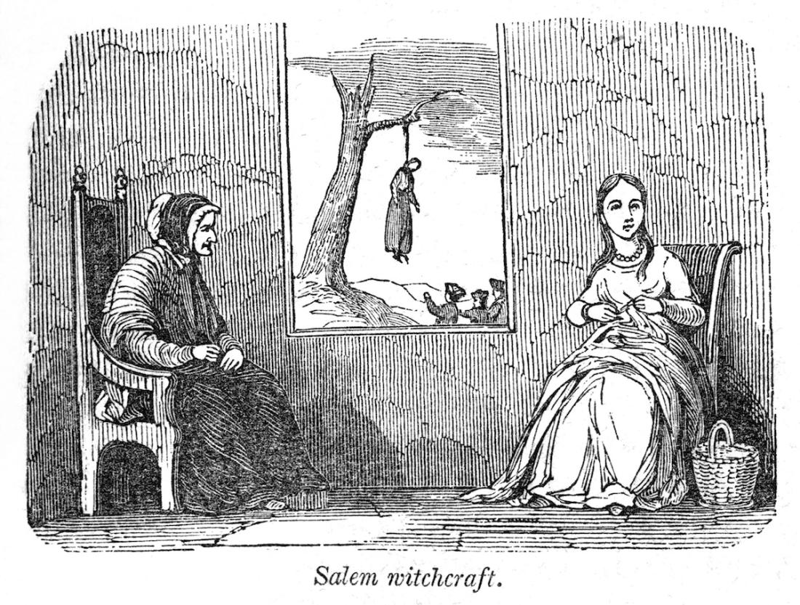
The Witch Trials

Slide 28
General Background
In 1692 a witch panic of epidemic proportions swept through Essex County, Massachusetts, beginning in Salem Village.
156 people were formally charged.
By early October when the governor William Phips halted the trials, 19 people had already been hanged and one hundred suspects were languishing in jail.

Slide 29
First Victims
The Salem Minister, Samuel Parris, was the father of one and uncle of another of the first girls to be “afflicted.” He encouraged them to “name their tormentors” and three women were arrested:
• Tituba, a Caribbean slave in Parris’ service
• Sarah Good, a homeless woman who begged around Salem Village
• Sarah Osborne, a native of Watertown who came to live in the village thirty years before

Slide 30
Multiple Backgrounds
Wilderness: “From the pulpit came reminders of New England’s many depredations. The wilderness qualified as a sort of ‘devil’s den’; since the time of Moses, the prince of darkness had thrived there.”
Providence: “Human frailty was understood to account for inclement weather: teeth chattering, toes numb, the Massachusetts Puritan had every reason to believe that they sinned flamboyantly.”
King Philip’s War: “A majority of the bewitched girls had lost their fathers; at least half were refugees from or had been orphaned by attacks in ‘the last Indian War.’ Those absences were deeply felt.”

Slide 31
Political Context
There is a political context with which the Witch Trials occur.
In 1684 England revoked Massachusetts’ charter.
Two years later it incorporated all their 8 colonies into what they called “the dominion of New England.”
The dominion took power away from the local officials and put it into the hands of royal agents: New Englanders would no longer elect their own officials including the governor; these positions would now be royal appointments.

Slide 32
Disestablishment
The royally appointed governor Edmund Andros took steps toward the disestablishment of Congregationalism in New England, forcing the South Church in Boston to hold Anglican services, and also reserving a plot of land for the construction of an Anglican church.

Slide 33
A Feeling of Invasiveness: the Catholic French
This period coincides with the rule of James II who succeeded his brother Charles II (both sons of Charles I), who was suspected of being Pro-Catholic and Pro-French.
The French were, of course, present in the Americas; and very near to the New England colonies—in Canada.
Because the seventeenth century English tended to associate autocratic or authoritarian political behavior with the Catholic Church and the French Monarchy, many New England colonists were under the impression that Andros was a Pro-French agent of the crown who sought to “destroy the fundamentals of the English and to erect a French Government.”

Slide 34
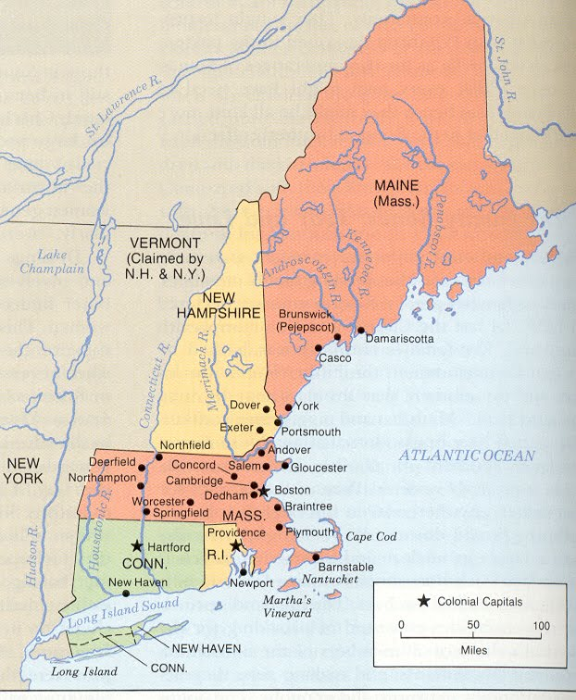
Colonial New England

Slide 35
From Popish Plots to Witches
“New England…was under attack—physically, politically and spiritually—during the last quarter of the seventeenth century.”
“In close and deadly succession, a series of external forces had assaulted the colonists, imperiling not only their integrity as a political and spiritual community but even their very survival.”
The language of invasion was the same whether the New English colonists were referring to this “popish plot” or to the witches.

Slide 36
Native Encounters
The New English were extremely afraid of losing their “English” identity.
They did not want to succumb to the “temptations of Indian life.”
They wanted to live in tight communities in which they could watch over their neighbors and meet frequently for worship.

